Slide 1
COMPUTER NETWORK

Slide 2
AGENDA
Computer network
Wan.man.lan.pan
Hardware
network connecting device
Network topology
Software
OSI MODEL
TCP/IP protocol
Window network command

Slide 3
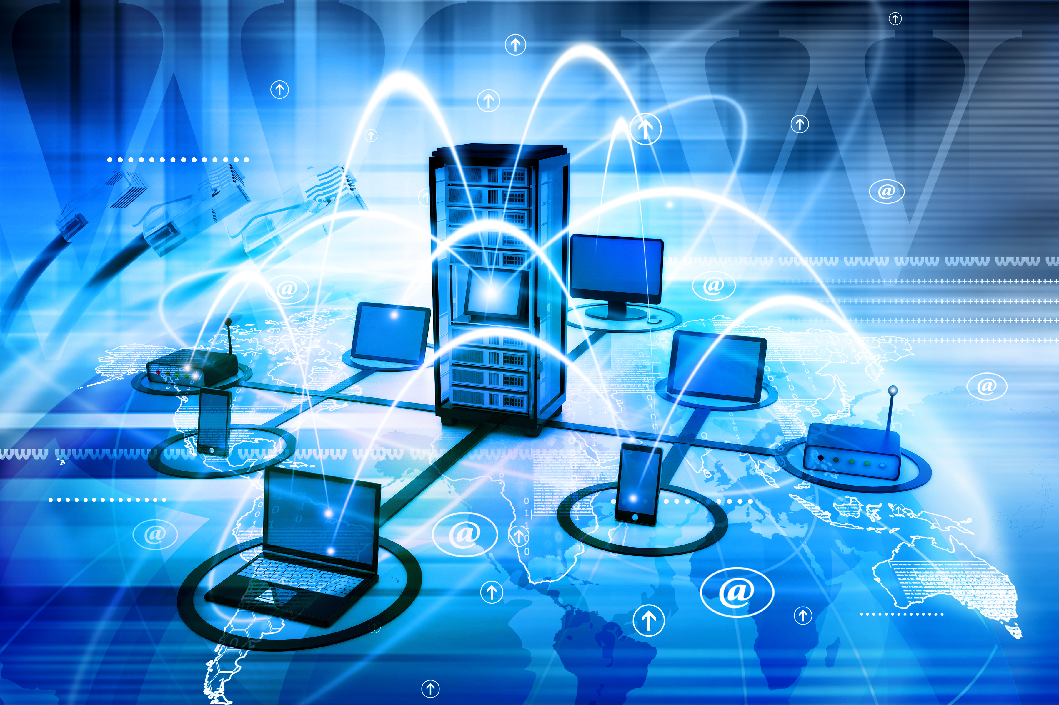
COMPUTER NETWORK
Computer networking
refers to interconnected computing devices that can exchange data and share resources with each other. These networked devices use a system of rules, called communications protocols, to transmit information over physical or wireless technologies.

Slide 4
HARDWARE: NERTWORK CONNECTING DEVICE
L1 devices: repeater hub
L2 devices: bridge switch
L3 devices: router L3 – switch;L3 ASIC + L2 switch
L4 devices:
L7 devices:

Slide 5
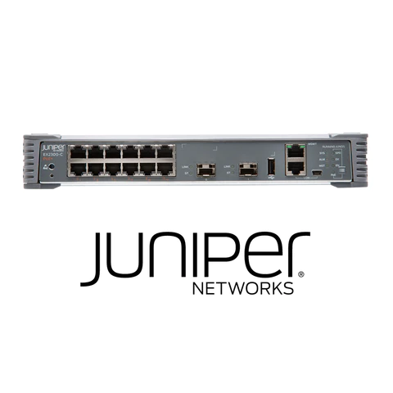
SWITCH VLAN

Slide 6
VLAN VIRTUAL LOCAL AREA NETWORK

Slide 7
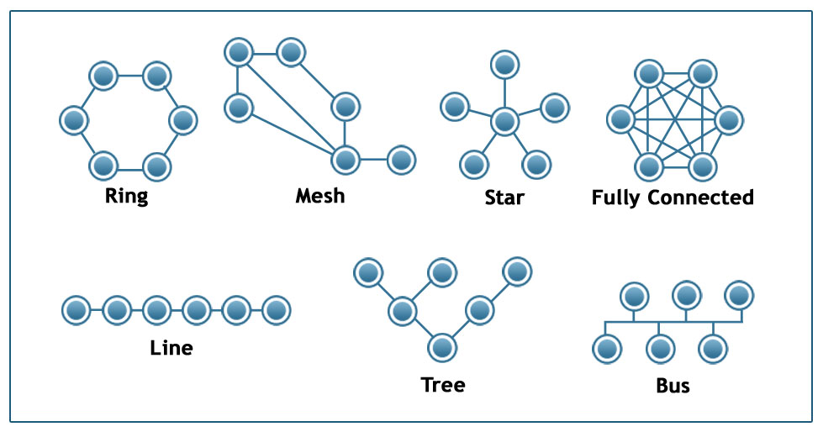
Network topology

Slide 8
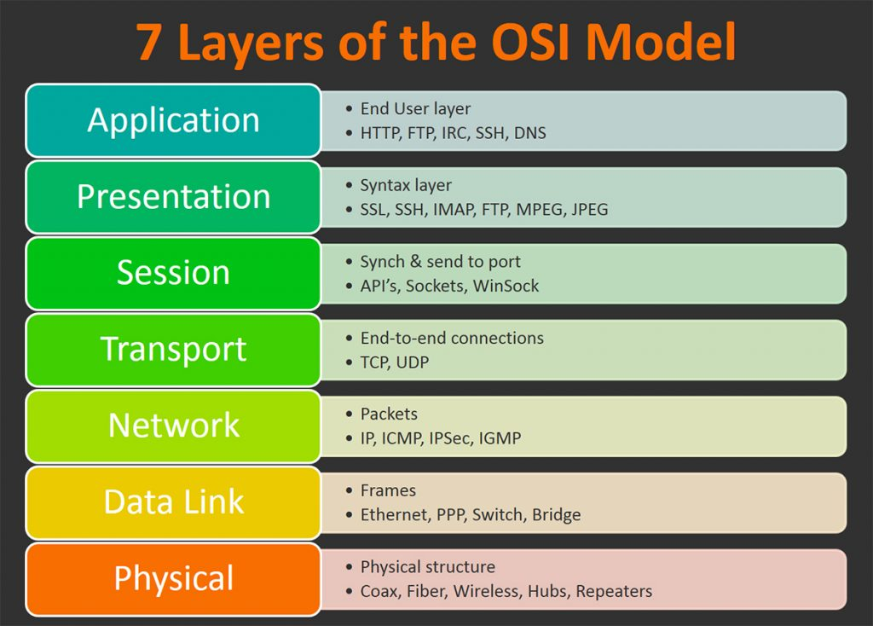
OSI MODEL

Slide 9
Mesh ‘LAN local area network

Slide 10
COMPUTER NETWORK:SOFT WARE

Slide 11
PHYSICAL

Slide 12
TCP/ICP PROTOCOL SUITE
PICTURE

Slide 13
HTTPS

Slide 14
COMPUTER NETWORK: WINDOW COMMAND

Slide 18
IP CONFIG
NESTRAT
PING

Slide 19
COMPUTER NETWORK

Slide 20
SCENARIO

Slide 21
Tools nestat + task manager + taskkill

